Slide 1
Firmware-mediated accelerators for edge AI
Tomeu Vizoso <tomeu@tomeuvizoso.net>

Slide 2
Accelerator drivers already in mainline
Qualcomm QAIC
AMD XDNA
Intel VPU/NPU
Intel HabanaLabs
Arm Ethos-U
Vivante VIP (Etnaviv)
Rockchip NPU (Rocket)
1 / 30

Slide 3
Accelerator drivers under review
Qualcomm QDA
  Hexagon DSP
  HMX and HVX ISA extensions
NXP Neutron
  RISC-V core
  Fixed-function accelerator bolted to the side
Texas Instruments C7x (Thames)
  C7x DSP cores
  SE/SA/MMA ISA extensions
2 / 30

Slide 4
Firmware-mediated accelerators
Kernel driver interacts with the hardware via IPC with the firmware
Userspace compiles payloads that run mostly unmodified on the hardware
Without a front-end processor in silicon, the other components need to pick up its tasks:
  Firmware uses HW facilities to isolate clients
  Kernel driver validates what the hardware cannot isolate
  Userspace takes care of tiling, ordering of operations and planning data movement
  Userspace coordinates the different accelerator components
3 / 30

Slide 5
Thames' goals
Simple UAPI, no hidden or grandfathered requirements
Security, performance and simplicity, in that order
Open source firmware
Everything needed is distributable by Yocto, Debian, Fedora, etc
Ready for Vulkan and OpenCL
A model for other drivers
4 / 30

Slide 6
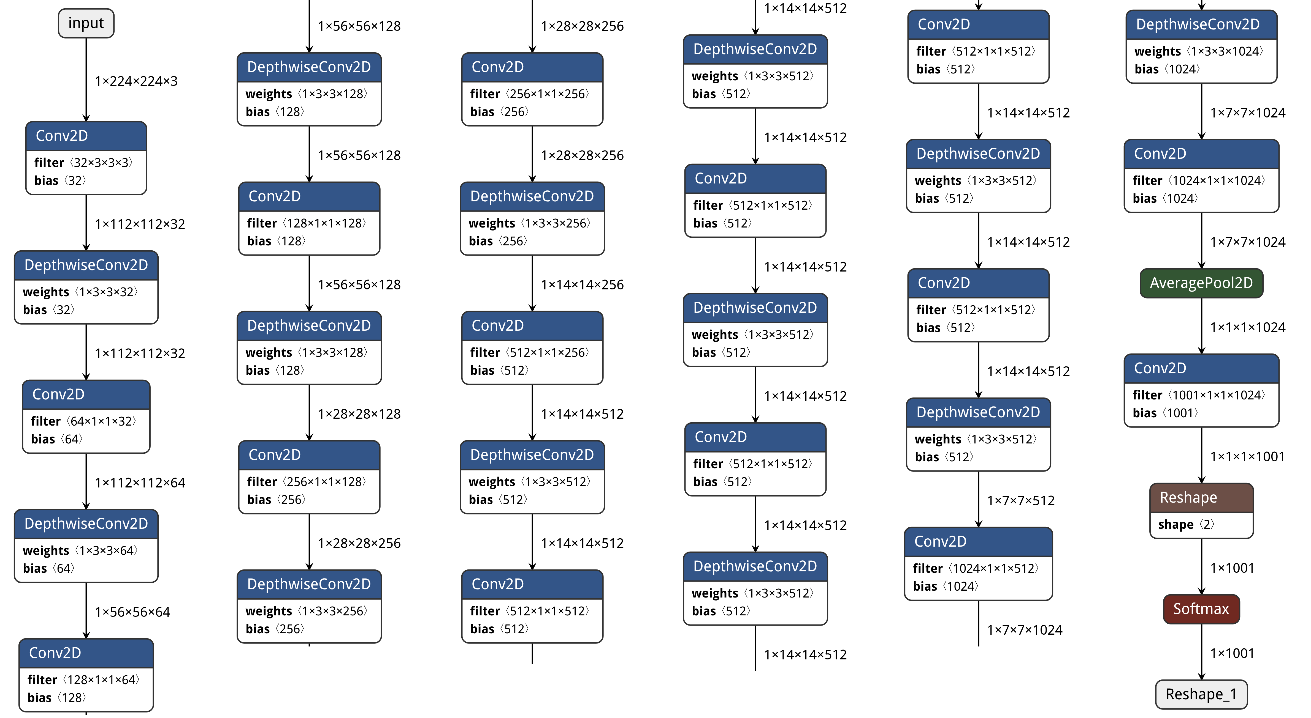
MobileNetV1: image classification
5 / 30

Slide 7
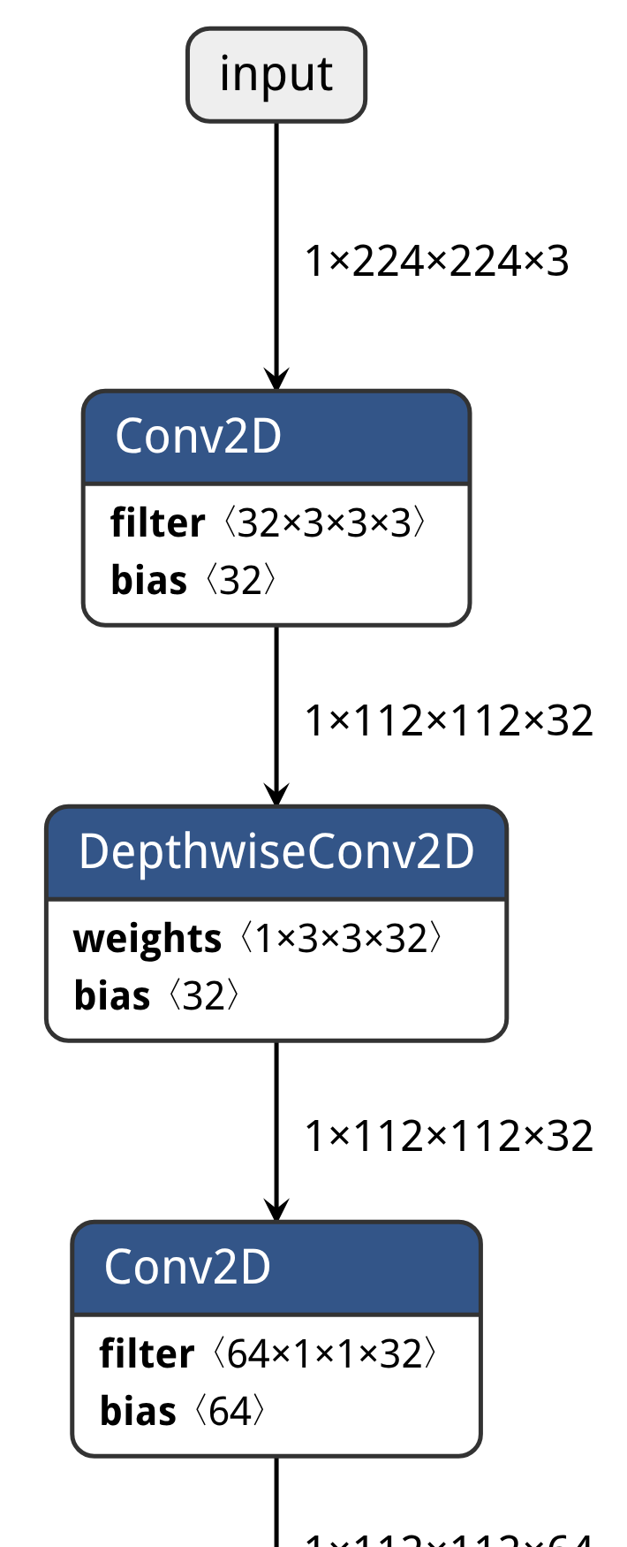
MobileNetV1: zoomed in
6 / 30

Slide 8
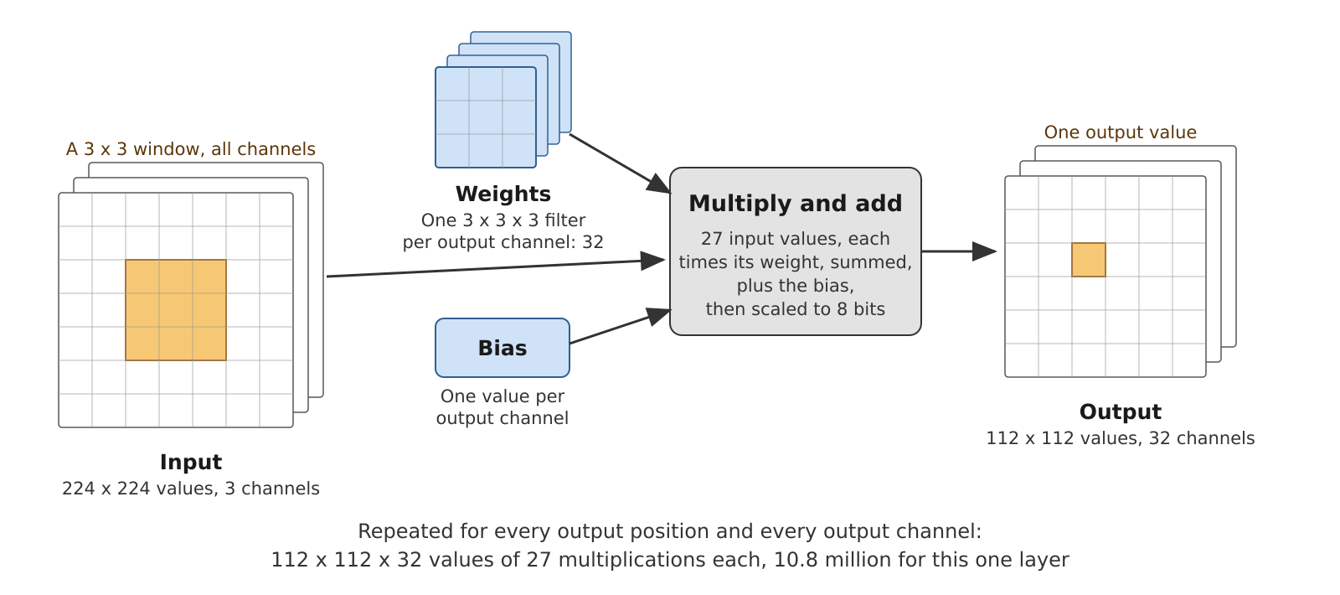
Neural network convolution
7 / 30

Slide 9
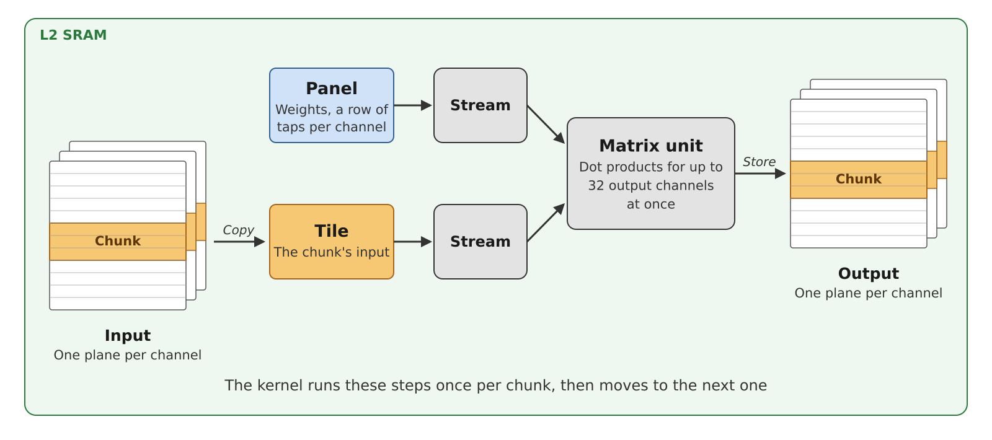
Computation pipeline
8 / 30

Slide 10
Texas Instruments' J722s and C7524
2 C7524 cores at 1 GHz, with each:
  32-byte vectors
  MMA2 (Matrix Multiply Accelerator 2) unit with 32x32 byte tiles
  2 Streaming Engines
  4 Streaming Address Generators
  MMU with VMSAv8-64 translation table format, 8-bit ASIDs
  2 MiB of main SRAM
  256 KiB of AUX SRAM
  1 DMA engine: DRU (Data Routing Unit)
9 / 30

Slide 11
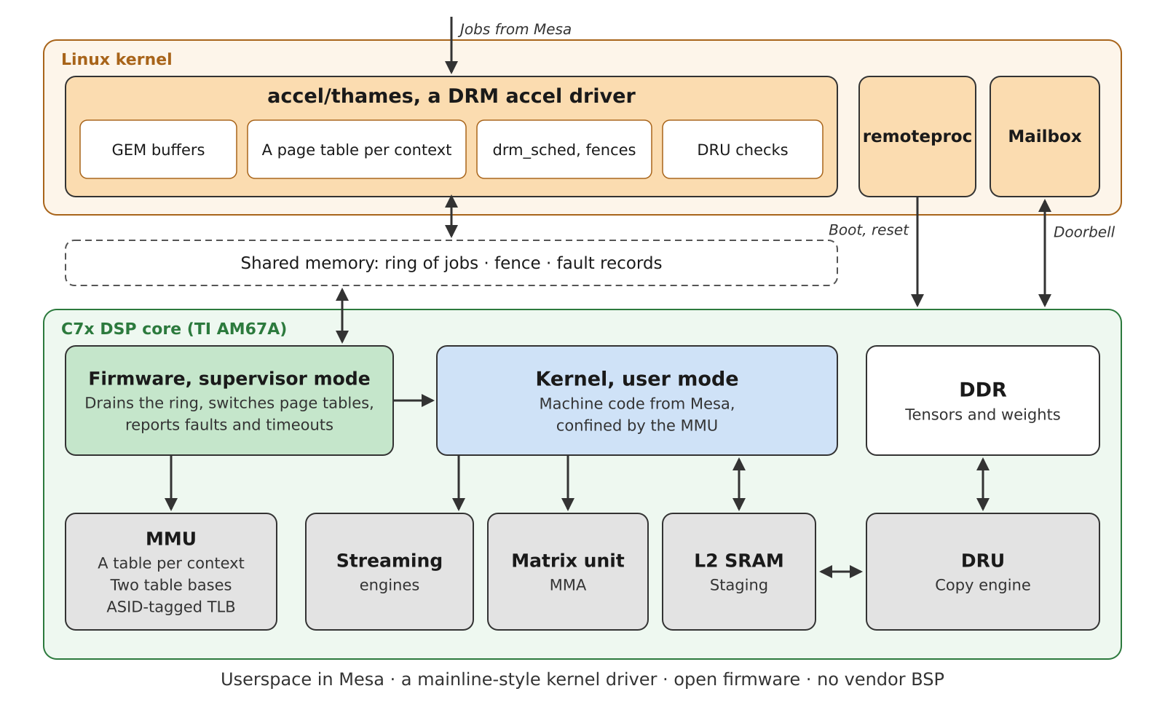
The complete pipeline
10 / 30

Slide 12
Component responsibilities
Userspace
  Compile DSP kernel
  Fill data structures
  Plan DMA transfers
Kernel driver
  Validate DMA transfers
  Load balance jobs among cores
  Manage the DSP address spaces
  Power management
  Ban contexts after repeated faults, and reset the cores
Firmware
  Accept jobs
  Context switching
  Configuration of DMA transfers
  Kernel execution in user mode
  Fault handling, job timeouts
11 / 30

Slide 13
Isolation among clients
A client cannot access other clients' memory, except those explicitly shared
Also applies to SRAM, registers and memory internal to the compute units
A client cannot disrupt other clients' execution
  Max job timeout
  Fault recovery
12 / 30

Slide 14
Firmware lifecycle
Remoteproc:
  Powers the device on, as described in the DT
  Loads the right firmware from the filesystem
Kernel driver:
  Gets the shared memory carveout from the firmware via remoteproc
  Handshakes with the firmware
    IPC version
    Capabilities
  Restarts the core after a FW fault or a hang
13 / 30

Slide 15
Graph compilation
Gallium driver receives a graph with a struct per operation
Each operation gets compiled into a subkernel, merged into a single one
Defines DMA transfers:
  Coefficients
  Input tiles too, where it pays
DSP kernel uses the Streaming Engines to stream the inputs in
Computation uses the MMA if suitable
Output will be placed in memory using the Streaming Address Generators
One DSP kernel, its parameters and its DMA plan per subgraph
14 / 30

Slide 16
UAPI at a glance
9 IOCTLs
Buffer create, mmap and destroy
Job create, submit and destroy
Device queries: capabilities and fault record
Buffer synchronization: prep and fini
15 / 30

Slide 17
Buffers in a job
DSP kernel (read-only, executable)
Parameters (read-only)
Constants (read-only)
Intermediate tensors (read-write)
Status (read-write)
Graph inputs (read-only)
Graph outputs (read-write)
16 / 30

Slide 18
DRM_IOCTL_THAMES_JOB_CREATE
Job descriptor
  DSP kernel
  Params BO
DMA transfers
int kernel(void *params)
Created once and submitted many times
17 / 30

Slide 19
DRM_IOCTL_THAMES_JOB_SUBMIT
Contents of params BO or other BOs might have changed
Handles of all BOs above, for implicit synchronization
In and out fences
Implicit wait when reading one of the writable BOs
Once the status BO becomes unblocked for reading, any faults can be processed
18 / 30

Slide 20
Memory management
Buffers are mapped to the DSP on creation
DSP virtual address is given to userspace
  To be referenced in the DSP kernel
  And in DMA transfers
Contiguous flag for DRU transfers
Alignment also important for performance
Access permissions on the DSP side
19 / 30

Slide 21
DSP address spaces
The supervisor in the firmware manages its own address space
Kernel driver manages the address spaces of clients
Each client has its own page table
ASIDs make context switching cheaper
20 / 30

Slide 22
Context switching
Switch page tables (172 cycles)
No TLB invalidation needed thanks to ASIDs
Clear SRAM (223k cycles)
Close streams and purge MMA unit (2k cycles max)
Registers wiped at every entry (18 cycles)
21 / 30

Slide 23
SRAM
Mapped at a fixed address
AUX and main
Much faster than DDR
Used for staging and intermediate buffers
22 / 30

Slide 24
DMA engine
Asynchronous data moves
Doesn't go via the MMU
On some SoCs it can decompress weights on the fly
Configuration apart from triggering
DDR -> SRAM: 12 bytes per cycle
SRAM -> SRAM: 31 bytes per cycle
Errors don't raise any faults: must be validated
23 / 30

Slide 25
Job validation
DMA commands
  DRU bypasses the MMU, so no isolation
  Userspace programs the actual DRU records
  Records are validated for correctness
  Kernel driver translates the addresses from virtual to physical
  Raise an error on invalid addresses and lengths
24 / 30

Slide 26
Job dispatch
drm_sched orders jobs between clients and chooses a core to execute them
One command ring per core in memory shared with the firmware
A mailbox doorbell interrupt wakes up the core when it's idle on an empty ring (3.5 us)
Completion is a fence
  A sequence number the device writes and the host reads
The firmware looks one entry ahead
  So the next job's first transfer can start while the current job still runs
25 / 30

Slide 27
Execution of a kernel
User execution mode:
  No access to other page tables
  No access to privileged registers
  Clean faults on privilege violations
DRU transfers:
  next chunk syscall
  transfer wait syscall
Kernel ABI: The only input argument is passed in A4, as is the return value
Exit syscall
26 / 30

Slide 28
Fault recovery
Faults caught by the supervisor, state cleared and fault record reported to the kernel driver
Same for timed out DSP kernels
Kernel driver will ban a context after faulting three times in the last 10 jobs
DSP core resets are expensive (94 ms)
  Only on faults and hangs from the firmware itself
27 / 30

Slide 29
Ready for OpenCL and Vulkan Compute
UAPI and IPC know nothing about ML
Kernels are untrusted
Per-job completion fence
Extensible UAPI, allows for adding:
  Input sync objects
  Timeline points
28 / 30

Slide 30
Current status
Firmware:
  Open-source
  Redistributable
  Needs closed source compiler
Fulfills DRM mainlining requirements
SSDLite MobileDet with TensorFlow Lite at 14.4 ms per frame
29 / 30

Slide 31
What is next
Power management
  Suspend/resume
  Runtime PM
Other hardware to be supported:
  TDA4VM (J721E)
  AM68 (J721S2)
  AM69 (J784S4)
  AM62A7
Performance work in userspace (target is ~5 ms for MobileDet)
Implement more operations so more models are accelerated
Test with PyTorch/Executorch
OpenCL, Vulkan
30 / 30

